Slide 1
Image Data Augmentation
Get started: edgeimp.com/evs23-data-augmentation

Slide 2
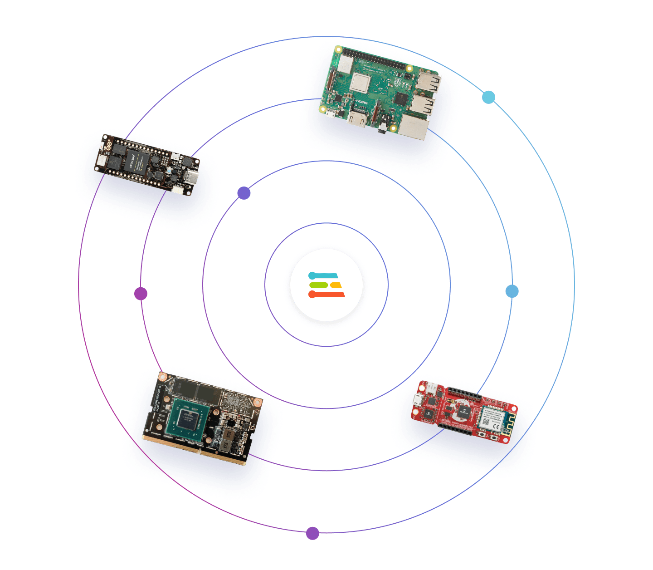
Agenda
Introduction
Why data augmentation
Hands-on workshop
Going further
Get started: edgeimp.com/evs23-data-augmentation

Slide 3
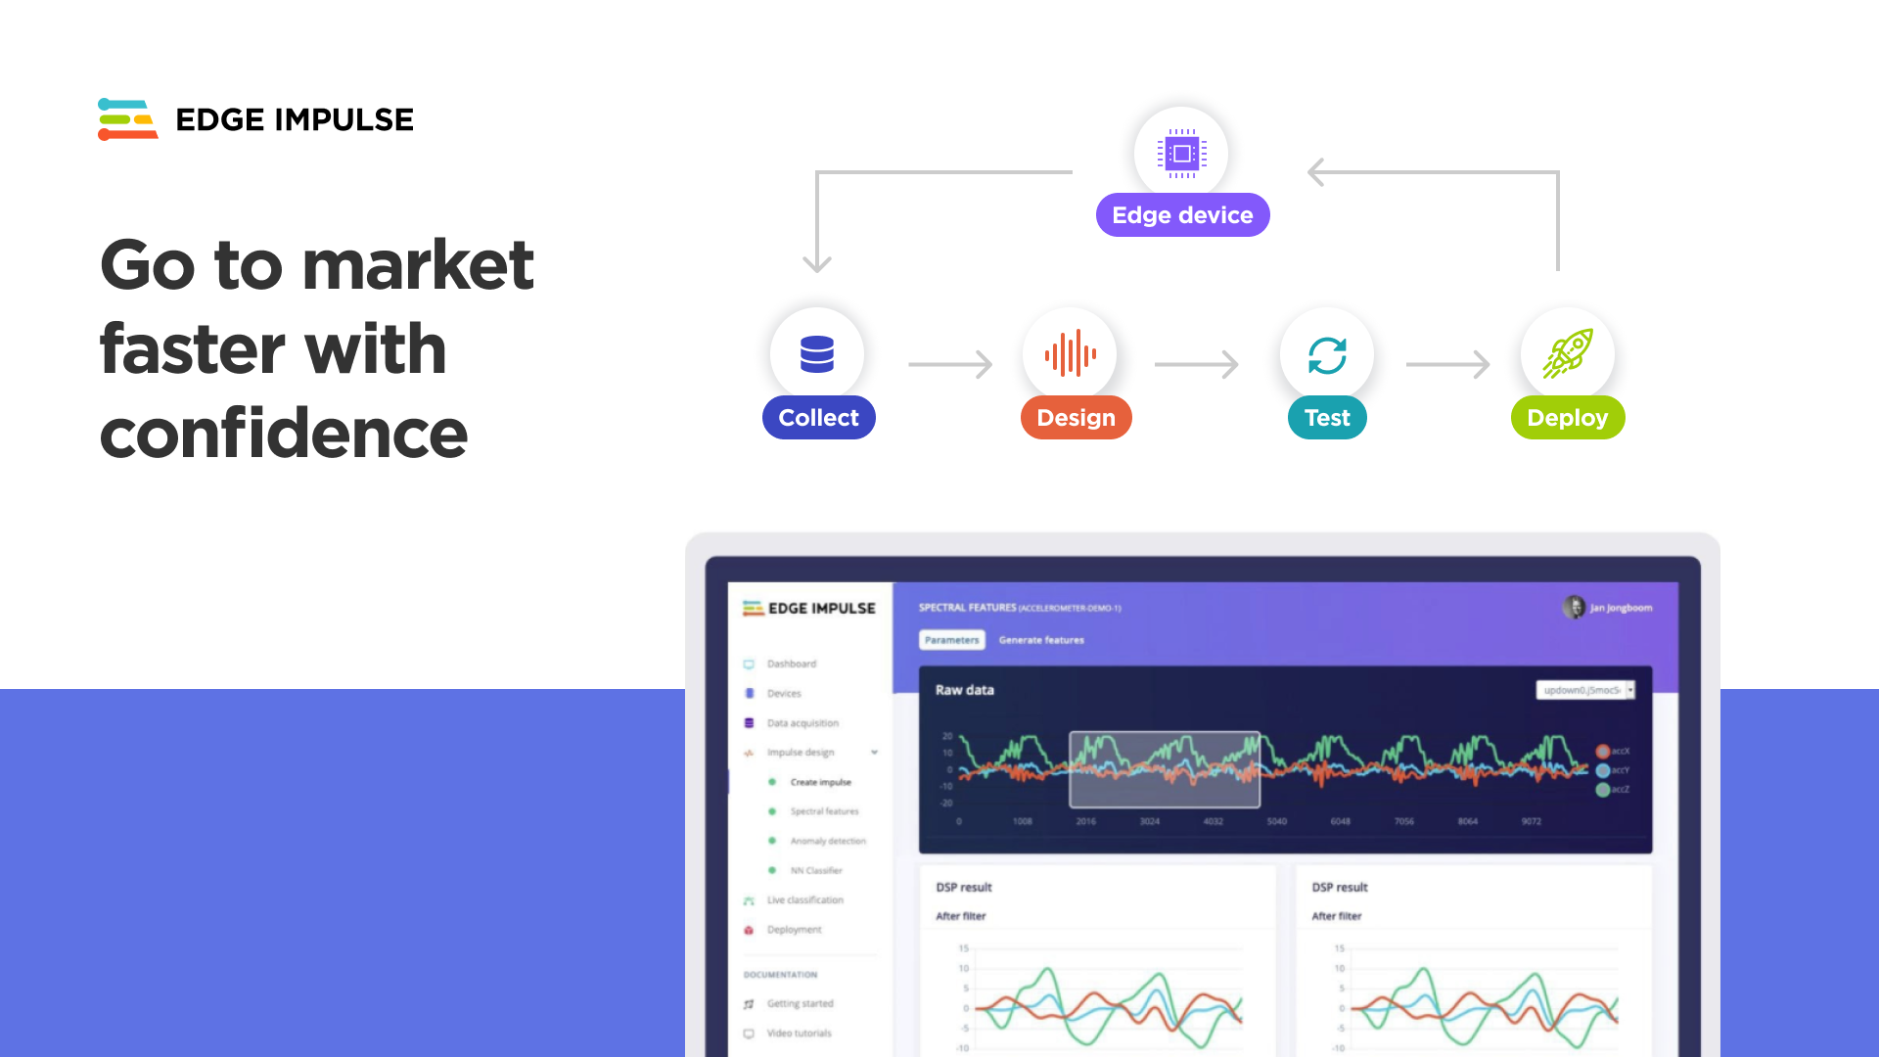
Notes:
Online platform
Collecting data - upload files or live from embedded device
Preprocessing feature extraction
Training model
Testing with saved and live data

Slide 4

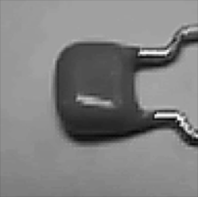
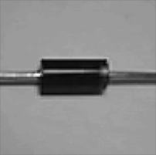
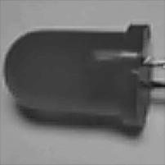
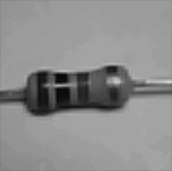
Image Classification
background
capacitor
diode
LED
resistor

Slide 5
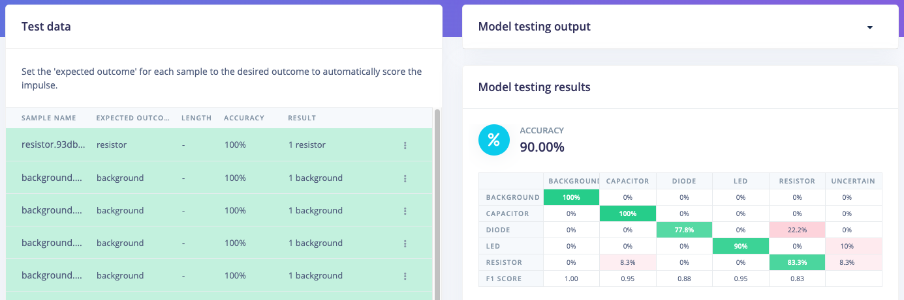
Hands-on: small dataset project
Get started: edgeimp.com/evs23-data-augmentation

Slide 6
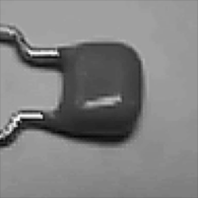
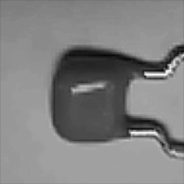
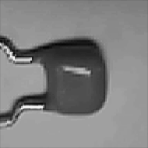
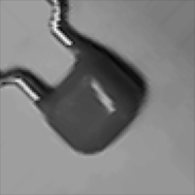
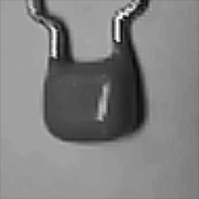

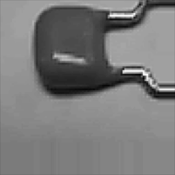
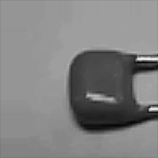
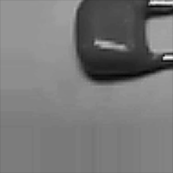
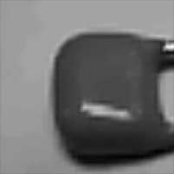
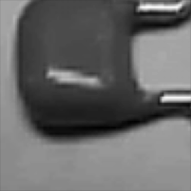
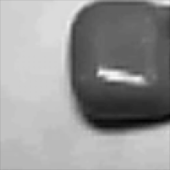
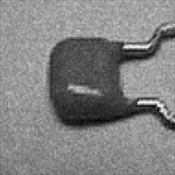
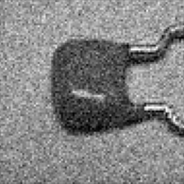
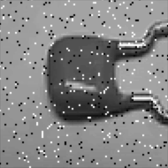
Data
Augmentation
flip
rotate
1 original image generates 15 augmented images
16 total images
250 original samples become 4000 samples
Not shown: compound transformations!
translate
original
zoom
noise

Slide 7
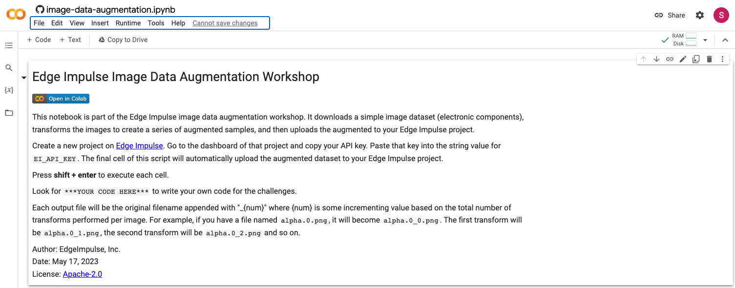
Hands-on: data augmentation
Get started: edgeimp.com/evs23-data-augmentation

Slide 8
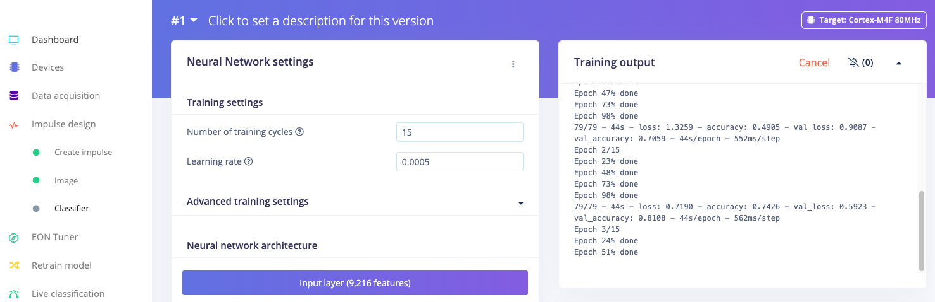
Hands-on: retraining the model
Get started: edgeimp.com/evs23-data-augmentation

Slide 9
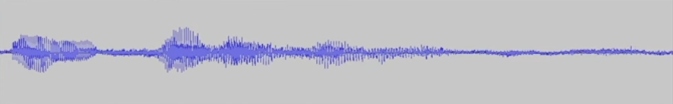
Going Further
Time series data augmentation
Frequency drop, shift
Translation
Mix background noise
Synthetic data
Generate data (e.g. with AI)
Text-to-speech for keyword spotting

Slide 10
Notes:
ROI Slide (Enterprise) - costly, 5 people, it will slow you down. Slow the ability to innovate and differentiate
Channel model - hardware target support or channel model

